Slide 1
Analysis of global wine market
WiWino Data Analysis

Slide 2
A market research analysis with:
Countries-17
Regions - 261
Wineries - 1020
Varieties of grapes-21
Flavor groups -13
Taste/aroma - 450

Slide 3
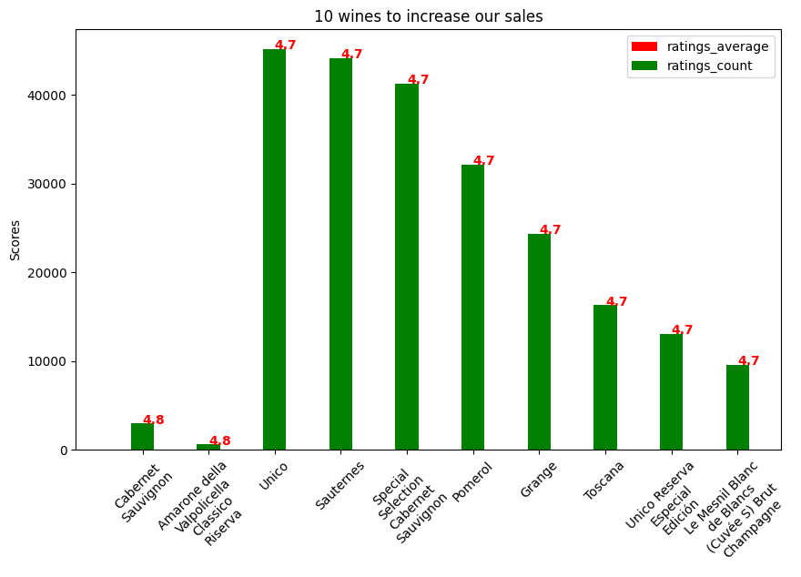

Slide 4
Countries to priorities for promotion with limited budget
 | Country | Wine count | Users count | Wineries count
1 | États-Unis | 74 | 12273684 | 28145
2 | France | 331 | 5973301 | 67553
3 | Italie | 383 | 4270717 | 42399
4 | Allemagne | 14 | 2549989 | 13643
5 | Espagne | 94 | 2264396 | 18026

Slide 5
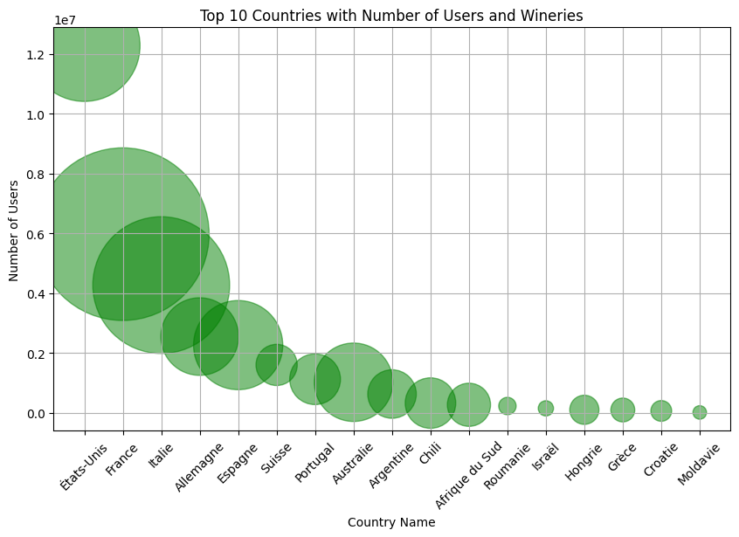

Slide 6
Best three wineries
 | Wineries Name | Rank | Ratings average | Ratings count
1 | Cabernet Sauvignon | 1 | 4.8 | 2941
2 | Toscana | 1 | 4.7 | 16284
3 | Château Margaux (Premier Grand Cru Classé) | 1 | 4.6 | 45350

Slide 7
Wines related with the aroma of: coffee, toast, green apple, cream, and citrus
Wine name | Aroma | Group name | Aroma_frequency | Users count
Vin Santo di Montepulciano | coffee | non_oak | 1482 | 4270717
St. Henri Shiraz | toast | microbio | 1354 | 1022965
Vin Santo di Montepulciano | cream | microbio | 767 | 4270717
Vin Santo di Montepulciano | citrus | citrus_fruit | 541 | 4270717
Tignanello | green apple | tree_fruit | 252 | 4270717

Slide 8
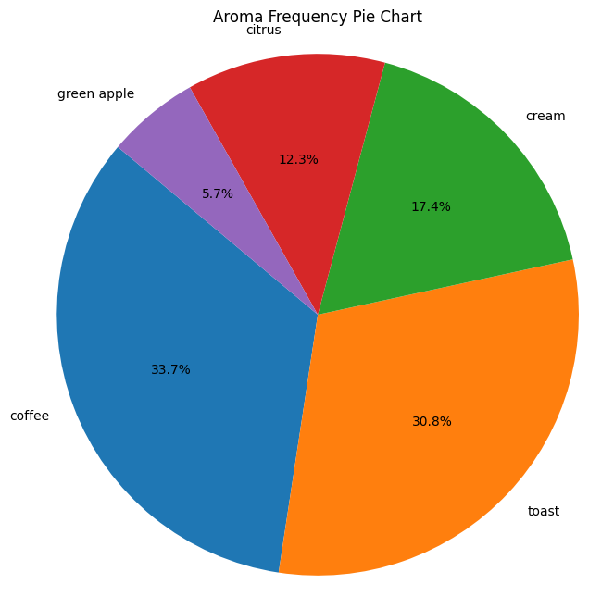
The customers who love these aromas are called “Breakfast enthusiast”

Slide 9
Top 3 most common `grape`s
 | Grape name | Grape id | Total wines count
1 | Cabernet Sauvignon | 2 | 9621012
2 | Merlot | 10 | 6233909
3 | Chardonnay | 5 | 3625248

Slide 10
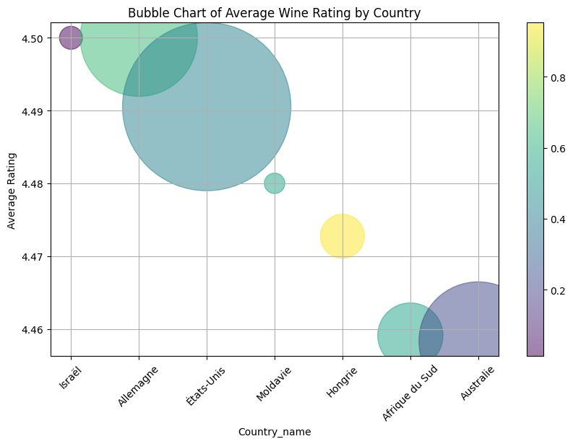

Slide 11
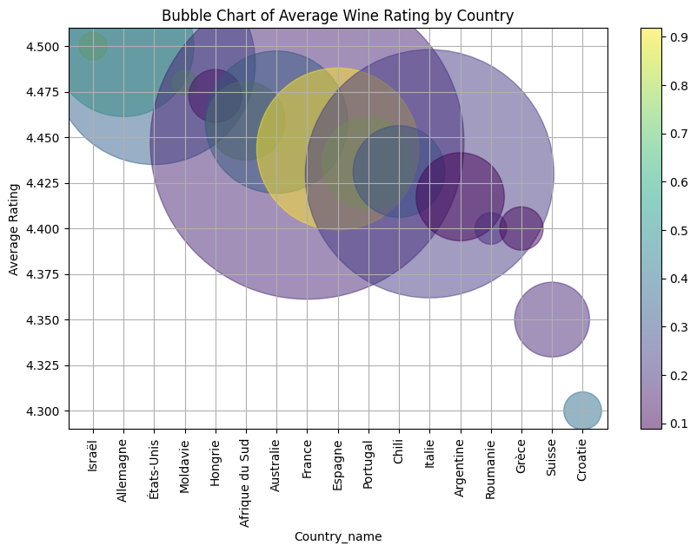

Slide 12
country_code | Award | rank | previous_rank
es | Bestsellers in Málaga | 1 | 11
sg | Bestsellers in Singapore | 1 | 12
it | Bestsellers in Italy | 1 | 4
es | Bestsellers in Córdoba | 1 | 14
ie | Bestsellers in Ireland | 2 | 9
us | Bestsellers in New Mexico | 2 | 15
us | Bestsellers in Tennessee | 3 | 8
ca | Bestsellers in Yukon | 3 | 11
ca | Bestsellers in British Columbia | 4 | 17
de | Bestsellers in Germany | 5 | 12
it | Bestsellers in Italy | 5 | 9
es | Bestsellers in Burgos | 6 | 10
pt | Bestsellers in Setúbal | 6 | 12
mc | Bestsellers in Monaco | 6 | 11
gb | Bestsellers in United Kingdom | 8 | 14
es | Bestsellers in Gipuzkoa (Guipúzcoa) | 19 | 20

Slide 13
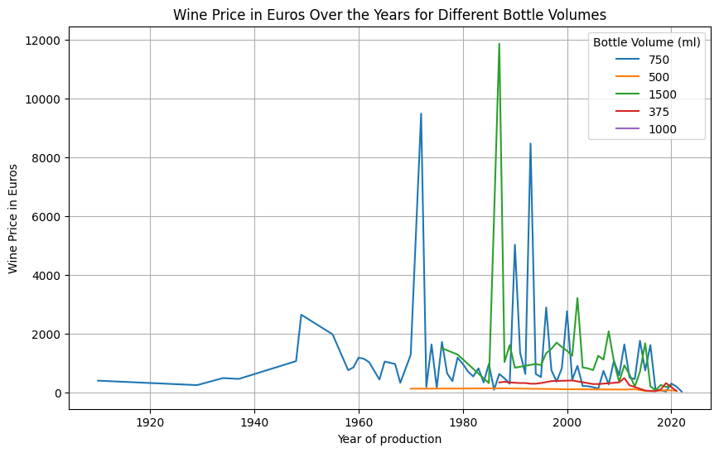

Slide 14
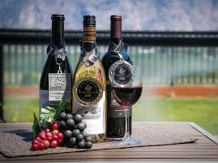
“In wine there is wisdom, in beer there is freedom, in water there is bacteria.”
Benjamin Franklin

